Slide 1
Analyzing Health Equity Using Household Survey Data
Lecture 9
Extensions to the Concentration Index:
Inequality Aversion & the Heath Achievement Index

Slide 2
Two extensions to the concentration index
CI incorporates implicit value judgements about aversion to inequality. It can be extended to allow different judgements.
CI measures inequality only but the level of health is also of concern. How can both inequality and the mean be incorporated into one index of health achievement?
Notes:
The concentration index is a useful tool for measuring inequalities in the health sector. It does, however, have limitations.
First, like the Gini coefficient, it has implicit in it a particular set of value judgments about aversion to inequality. This lecture shows how to operationalize Wagstaff’s (2002) “extended” concentration index, which allows attitudes to inequality to be made explicit, and to see how measured inequality changes as the attitude to inequality changes.
The second drawback of the concentration index—and the generalization of it—is that it is just a measure of inequality. Although equity is an important goal of health policy, it is not the only one. It is not just health inequality that matters; the average level of health also matters. Policy makers are likely to be willing to trade one off against the other—a little more inequality might be considered acceptable if the average increases substantially. This points to a second extension of the concentration index (Wagstaff 2002): a general measure of health “achievement” that captures inequality in the distribution of health (or some other health sector variable) as well as its mean.

Slide 3
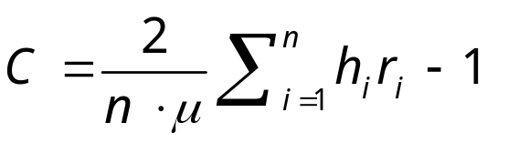
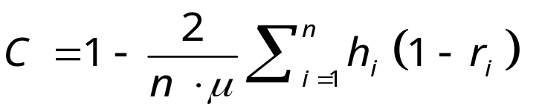
The concentration index is a weighted sum of individual health shares
where h is health,
μ its mean, r fractional
rank
As seen in lecture 8:
This can be written as:
So, in the summation, the health share of each indv., h_{i}/nµ, is
weighted by 2 (1 - r_{i})
Thus, C is one minus sum of weighted health shares with weights linearly declining from 2 for poorest to 0 for richest individual.
Notes:
1. In the first equation we omit the term 1/n, which goes to zero as the sample size increases. The notation is the same as in lecture 8, h is the health variable. R the fractional rank in the living standards distribution and μ is the mean of the health variable.

Slide 4
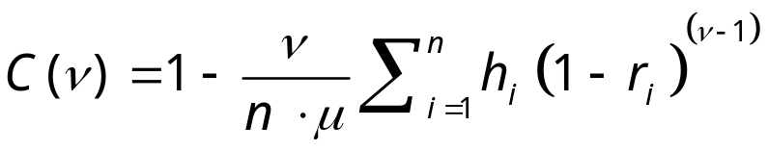
An extended concentration index
Like Yitzhaki’s (1983) extended Gini , one can define an extended CI as (Wagstaff, 2003)
where the inequality aversion parameter v (≥1) embodies ethical value judgements about the extent to which there is aversion to inequality such that greater weight is placed on the health share of poorer relative to richer individuals.
v=1 → everyone’s health is weighted equally (C(1)=0)
v=2 → the linearly declining weighting scheme of the standard concentration index (C(2)=C)
v>2 → the weight attached to the health of the poorest person is ν, and declines non-linearly to zero for the richest person
Notes:
When v=1, equal weight is given to each indvs health irrespective of income and so the weighted sum of the health shares is 1 and the index is 0, irrespective of the degree of inequality, since there is no concern about inequality.
1<v<2 puts more weight on the health of poorer indvs but not as much as is given in the standard CI
v=2 gives the weights used in the standard concentration index.
v>2 puts relatively more weight on the health of poorer indvs than is the case in the standard CI. And the weights decline non-linearly.

Slide 5
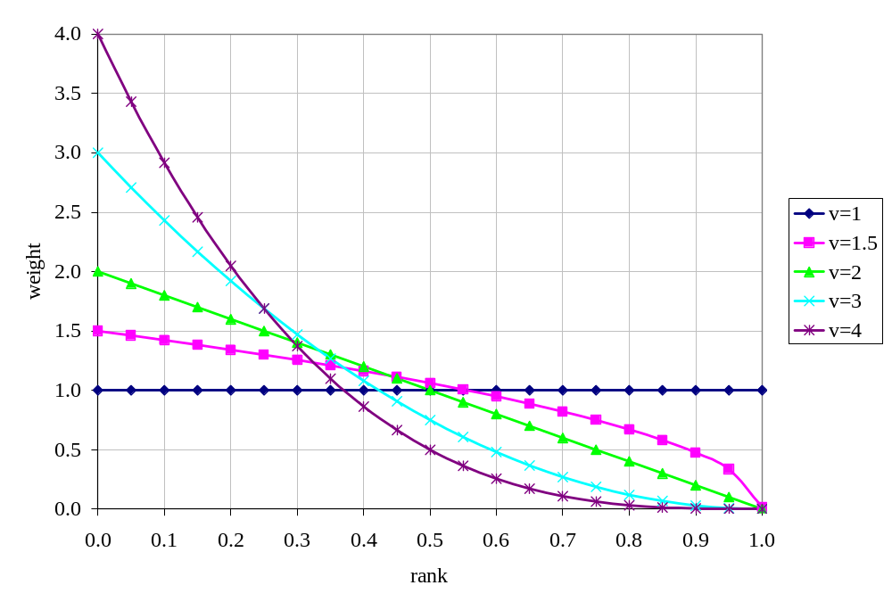
Alternative weighting schemes for extended concentration index

Slide 6
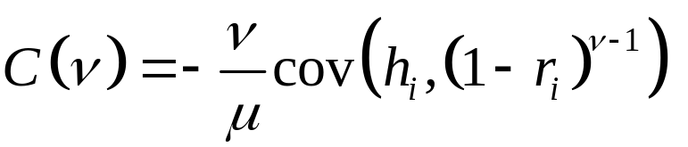
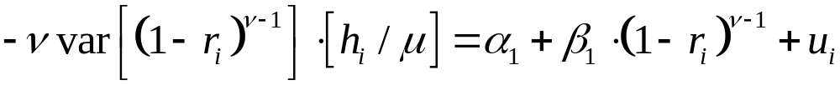
Estimating the extended CI
By convenient covariance method:
Can be calculated for
different values of v
By convenient regression method:
OLS estimate of β₁ is the extended CI

Slide 7
Measures of socioeconomic-related inequality in malnutrition in Vietnam with different degrees of inequality aversion
Negative of height-for-age z-score
A negative CI indicates more malnutrition among the poor
As the inequality aversion parameter is raised, the measured degree of inequality increases
v | C(v)
1 | 0.00
2 | -.0771886
3 | -.11006521
4 | -.12858764
5 | -.14068989
Notes:
1. As an example, we compute the extended concentration index for values n = 1, n = 2, n = 3, n = 4, and n = 5 for (the negative of) height-for-age for children in the 1993 Vietnamese Living Standards Measurement Study. (The negative of the height-for-age variable captures malnutrition, the rate of which is higher among poorer children, so C < 0.) These are the same data used by Wagstaff, van Doorslaer, and Watanabe (2003). We know, of course, that C(1) = 0. We also know from Wagstaff, van Doorslaer, and Watanabe (2003) that for the year 1993 C(2) is equal to ‑0.077(cf. Wagstaff, van Doorslaer, and Watanabe 2003, p. 213)

Slide 8
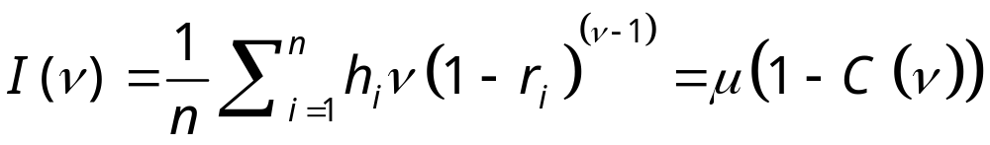
Taking account of the level and the distribution of health
If there is concern for the level of health, and not only socioeconomic-related inequality in its distribution, then may want a summary statistic to reflect mean health in addition to this inequality.
Might refer to such a measure as an index of ‘health achievement’.
While the extended CI allows for different degrees of inequality aversion, it places no weight on the mean of the distribution. For example v=1, C(1)=0 irrespective of the value of the mean.
An index of health achievement can be obtained by taking a weighted average of levels of health, rather than of health shares, as follows:
That is simply the product of the mean and one minus the extended CI.
So, for a desirable health variable, increases in the mean may be traded-off against increases in pro-rich inequality
For a non-desirable health variable, decreases in the mean can be traded-off against increases in its concentration on the poor.

Slide 9
The level of malnutrition in Vietnam weighted by the degree of socioeconomic-related inequality in its distribution
Negative of height-for-age z-score
So a higher value indicates more inequality-weighted malnutrition
As the inequality aversion parameter is raised, inequality-weighted malnutrition increases
v | C(v) | I(v)
1 | 0.00 | 2.030
2 | -.0771886 | 2.187
3 | -.11006521 | 2.253
4 | -.12858764 | 2.291
5 | -.14068989 | 2.315
Notes:
1. With v=1, I(1)=mean. Thereafter, the index increases as more weight is placed on the inequality to the disadvantage of the poor.

Slide 10
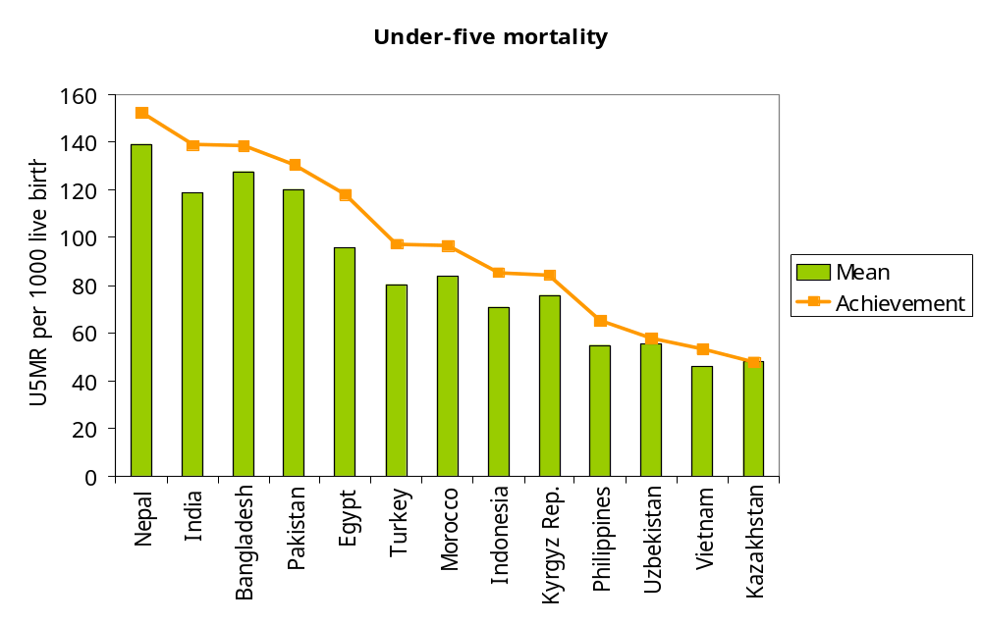
Mean and inequality-weighted mean in under-five mortality
Notes:
Differences in means obviously dominate those in socioeconomic-related inequality.
But there are some examples of rankings differing due to the distribution of child deaths. For example, compare India with Bangladesh. India has the lower rate of mortality, but there is little or no difference in the achievement indices meaning that child deaths are relatively more concentrated on the poor in India. Similarly, note Vietnam has a higher index than Kazakhstan despite have a lower rate of mortality.

Slide 11
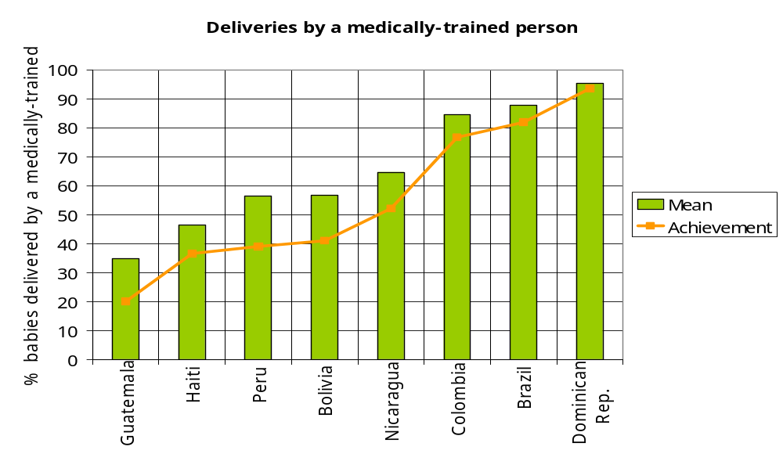
Mean and inequality-weighted mean of medically attended births
Notes:
In this case the variable is desirable but its distribution is pro-rich. Consequently, the inequality-weighted means (achievement indices) lie below the means. That is, the level of medically attended births is less impressive if one has aversion to the pro-rich distribution of this service.
The discrepancies are greatest in the countries with the lowest means indicating that cross-country differences in the level of provision are exacerbated once allowance is made for distribution of the service.

